Slide 1
Section 4.6 Applied Optimization
In our life, you will encounter the following questions: What are the dimensions of a rectangle with fixed perimeter having maximum area? What are the dimensions for the least expensive cylindrical can of a given volume? How many items should be produced for the most profitable production run? Each of these questions asks for the best, or optimal, value of a given function. In this section we use derivatives to solve a variety of optimization problems in business, mathematics, physics, and economics.

Slide 2
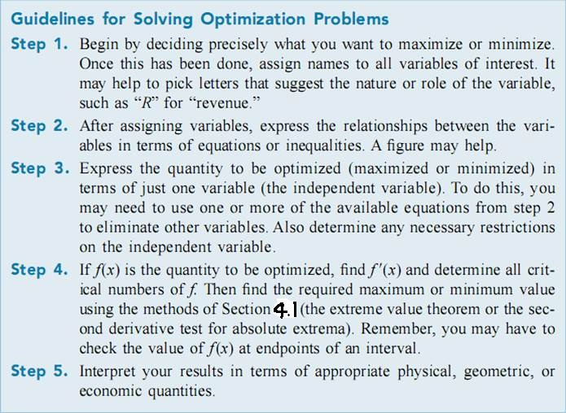

Slide 3
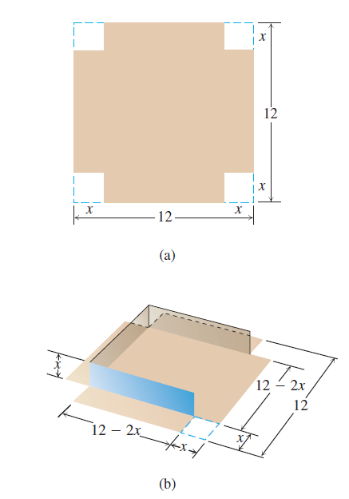
Example 1
An open-top box is to be made by cutting small congruent squares from the corners of a 12-in.-by-12-in. sheet of tin and bending up the sides. How large should the squares cut from the corners be to make the box hold as much as possible?

Slide 5
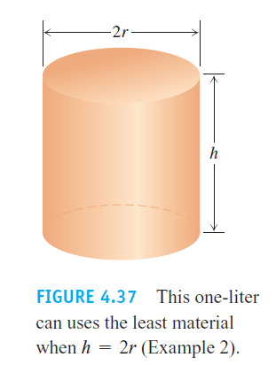
EXAMPLE 2 You have been asked to design a one-liter can shaped like a right circular cylinder (Figure 4.37). What dimensions will use the least material?

Slide 7
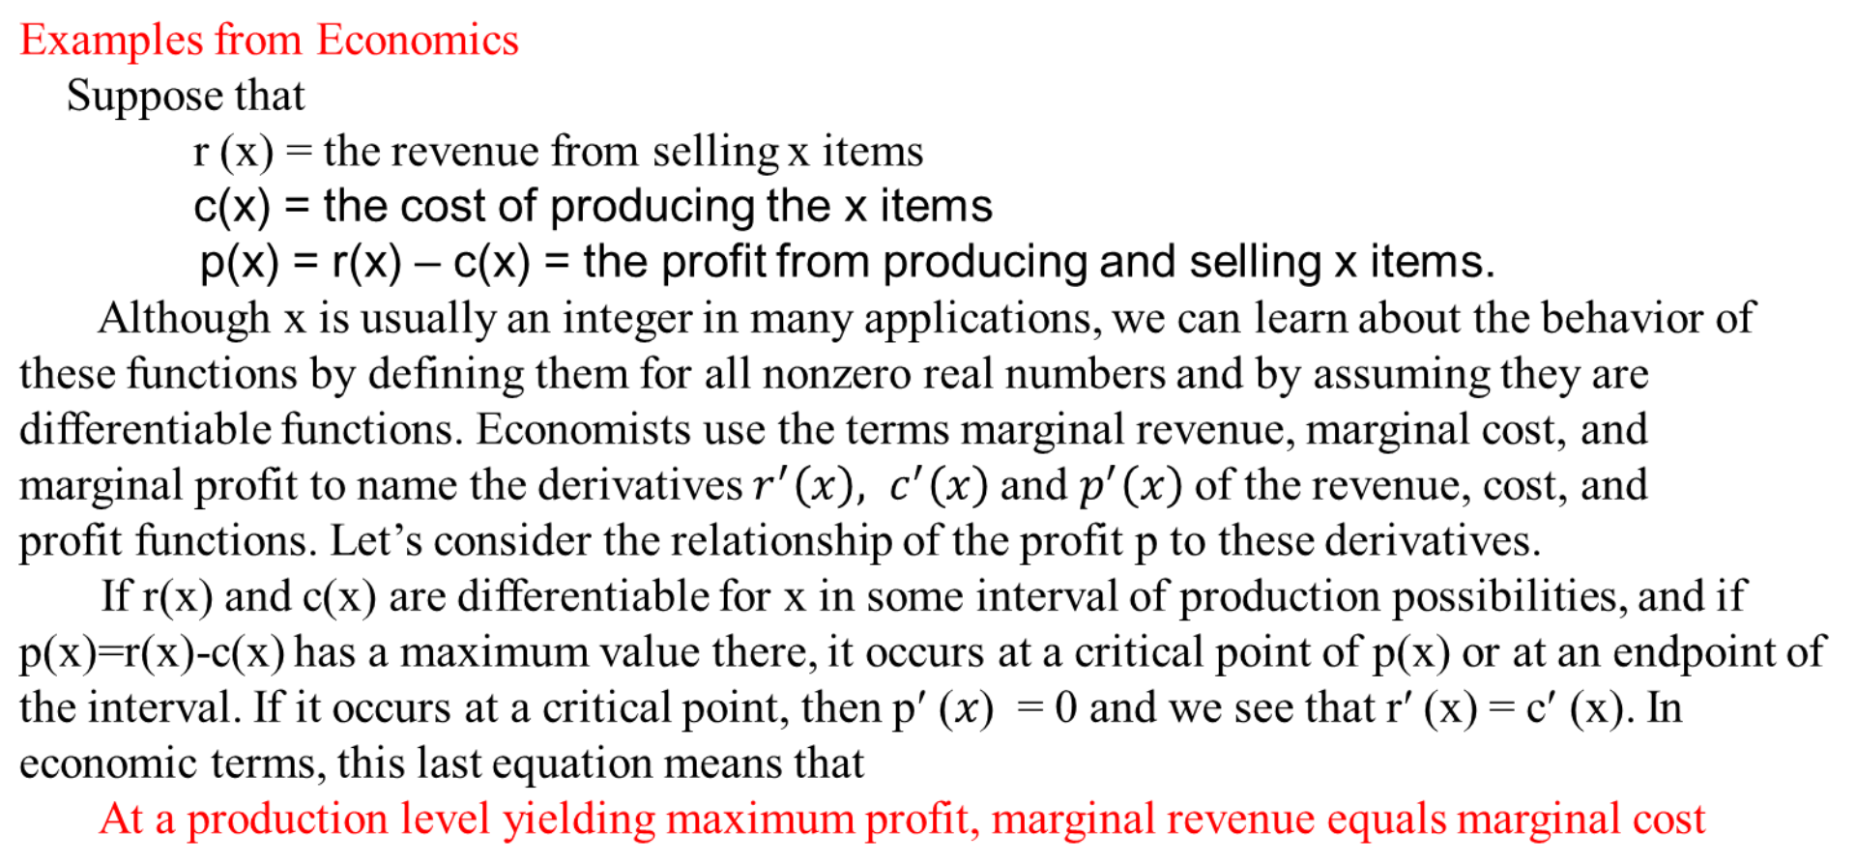

Slide 8

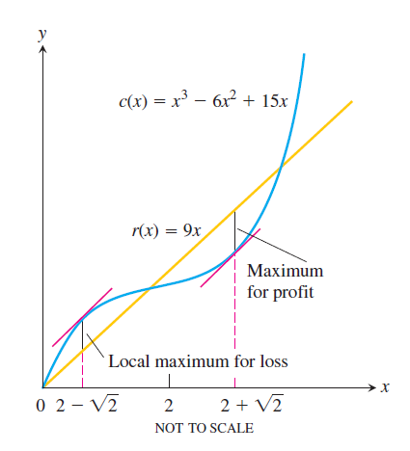

Slide 9
Homework: Page269 10, 17

